Slide 1

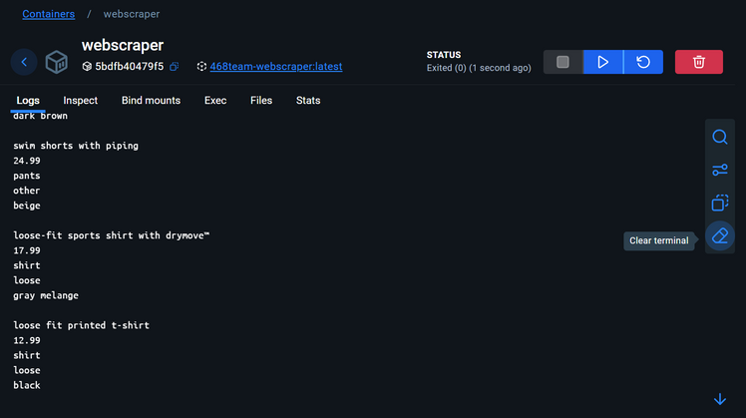
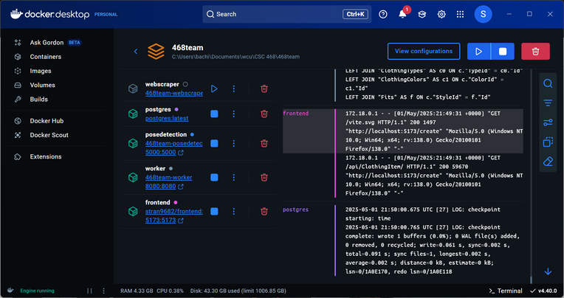
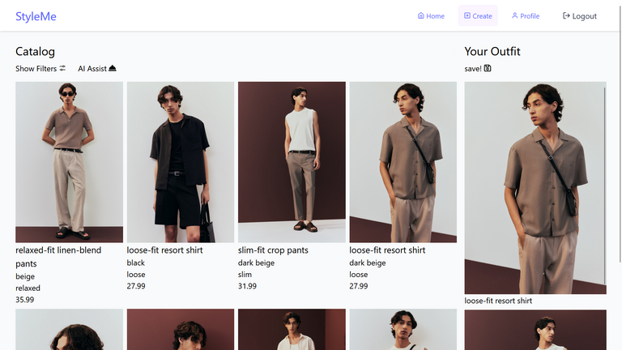
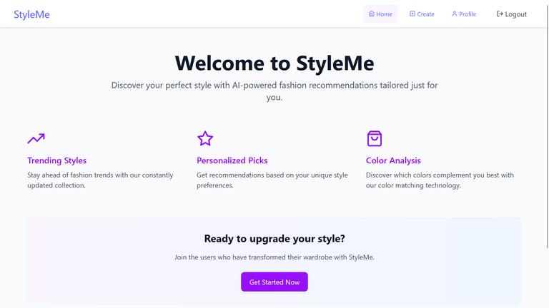
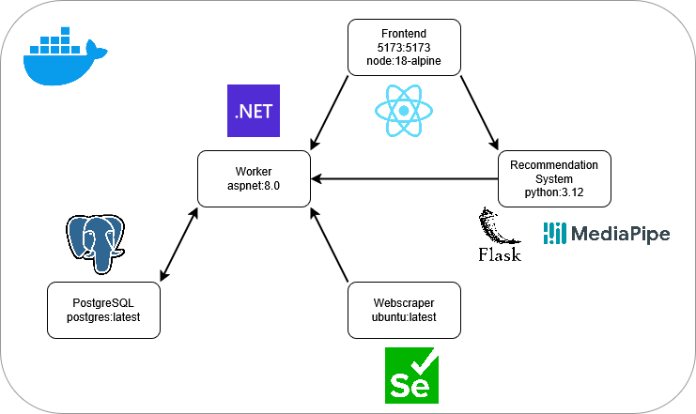
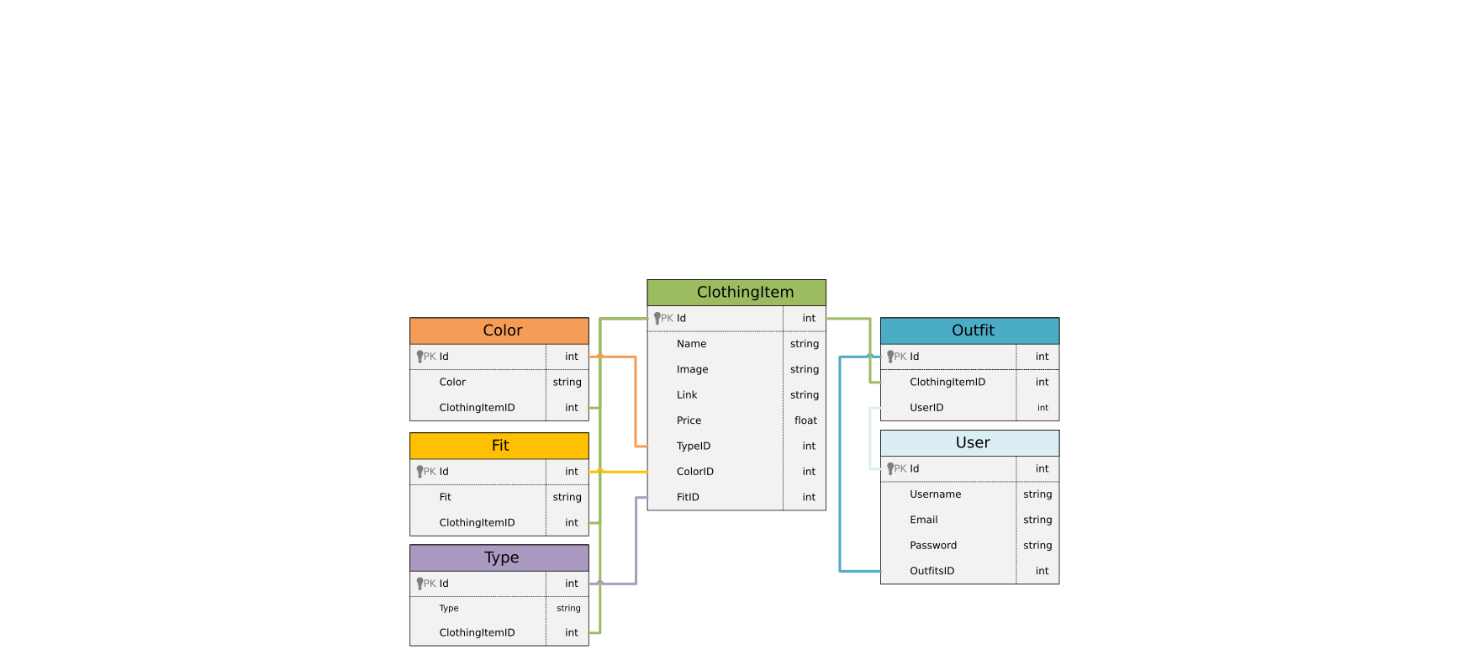
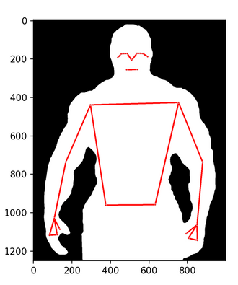
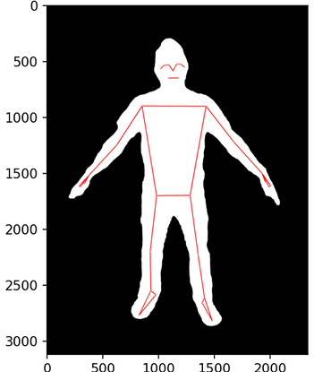
StyleMe
StyleMe uses computer vision to help pick an outfit for you!
StackOverflowers
Chris Eardley, Danny Halovanic, Haja Koroma, Sebastian Tran
Webscraper
Docker Compose
Front End
Deployment
Database Schema
Segmentation Mask
Notes:
FINAL NOTES: make the segmentation mask pictures side by side. the database schema is too big, make it smaller. it makes more space for the frontend. Provide context to the outfit; party, business outfit, etc. Provide the (affiliate) link to each image - great for monetization. Or possibly creating a free/paid version. Additionally, it could be sold to H&M. Store the parameter. Keep a pixelated image that the user uploaded. Grab everything below the neck (when it comes to storing.)

